Slide 1
Control statement

Slide 2
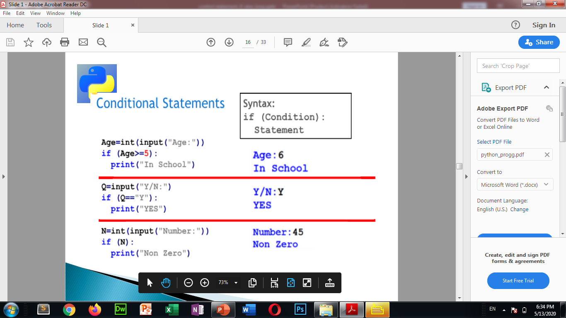

Slide 3
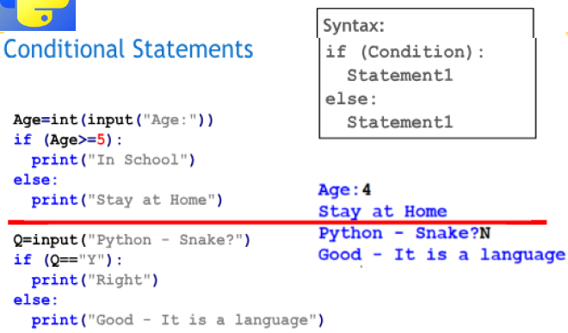

Slide 4
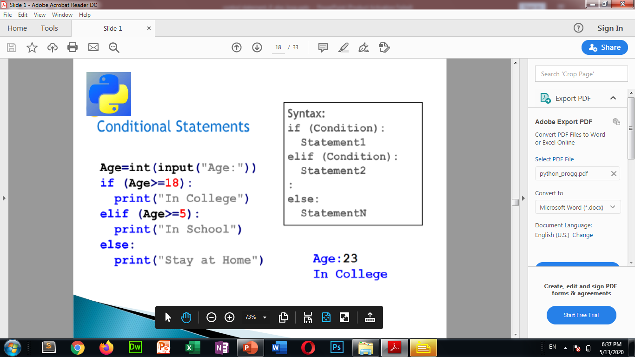

Slide 5
Loop- same task perform repeatedly until the condition is satisfied.
Initialization (a=1)
Condition (a<5)
Increment decrement (a+=1)

Slide 6
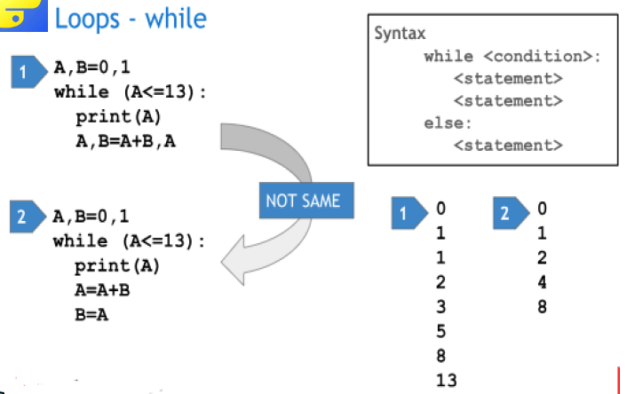

Slide 7
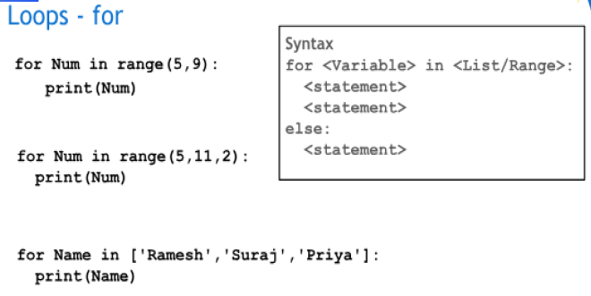

Slide 8
Let us practice some practical programs

